Slide 1

Time Series models: AR, MA, ARIMA
Anant Dashpute
SC20M144
Machine Learning And Computing

Slide 2


Overview
Introduction of Time Series Terminologies
White Noise and Random Walk Time Series Analysis
ARIMA Models AR ,MA Process Models ARIMA
ARIMA Modeling: Problem

Slide 3
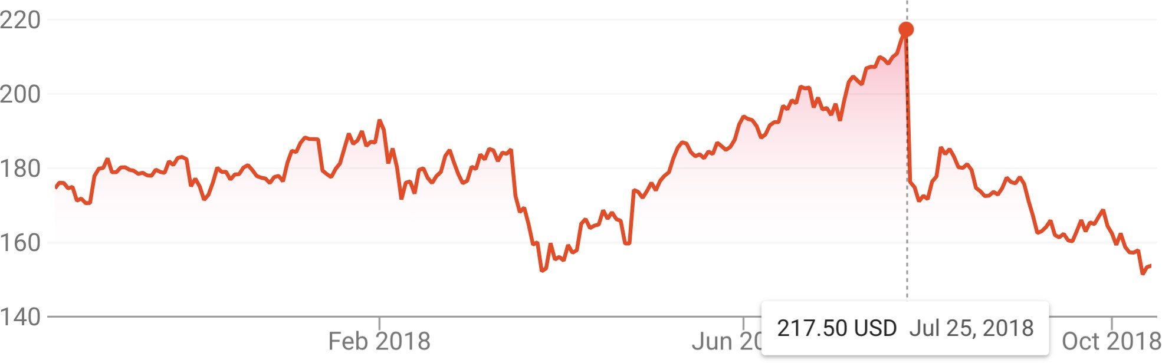
Time Series
A time series is a sequential set of data points, measured typically over successive times.
Time series analysis comprises methods for analyzing time series data in order to extract meaningful statistics and other characteristics of the data.

Slide 4
Components of a Time Series
In general, a time series is affected by four components, i.e. trend, seasonal,cyclical and irregular components.
– Trend
The general tendency of a time series to increase, decrease or stagnate over a long period of time.
110
cents per pound
60 70 80 90
2005 2010 2015
The price of chicken: monthly whole bird spot price, Georgia docks, US cents per pound, August 2001 to July 2016, with fitted linear trend line.

Slide 5
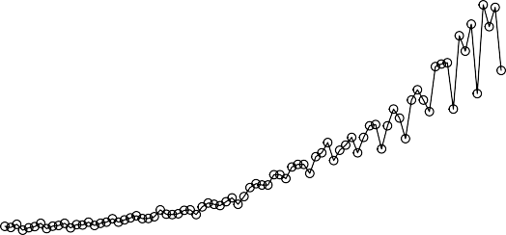
– Seasonal variation
This component explains fluctuations within a year during the season, usually caused by climate and weather conditions, customs, traditional habits, etc.
Quarterly Earnings per Share
15
10
5
0
1960 1965 1970 1975 1980
Johnson & Johnson quarterly earnings per share, 84 quarters, 1960-I to 1980-IV.

Slide 6
– Cyclical variation
This component describes the medium-term changes caused by circumstances, which repeat in cycles. The duration of a cycle extends over longer period of time.
130
110
90
70
1970 1972 1974 1976 1978 1980
Average weekly cardiovascular mortality in Los Angeles County. There are 508 six-day smoothed averages obtained by filtering daily values over the 10 year period 1970-1979.

Slide 7
– Irregular variation
Irregular or random variations in a time series are caused by unpredictable influences, which are not regular and also do not repeat in a particular pattern.
These variations are caused by incidences such as war, strike,
earthquake, flood, revolution, etc.
There is no defined statistical technique for measuring random fluctuations in a time series.

Slide 8
Combination of Four Components
Considering the effects of these four components, two different types of models are generally used for a time series.
Additive Model
Y (t) = T (t) + S (t) + C (t) + I (t)
Assumption: These four components are independent of each other.
Multiplicative Model
Y (t) = T (t) × S (t) × C (t) × I (t)
Assumption: These four components of a time series are not necessarily independent and they can affect one another.

Slide 9
Time Series Example: White Noise
White Noise
– A simple time series could be a collection of uncorrelated random variables, {w_{t} }, with zero mean µ = 0 and finite
2 2
variance σ , denoted as w ∼ wn(0, σ ).
w
t
w
Gaussian White Noise
– A particular useful white noise is Gaussian white noise, wherein the w_{t} are independent normal random variables (with mean 0
2 2
and variance σ ), denoted as w ∼ iid N (0, σ ).
w t w
White noise time series is of great interest because if the stochastic behavior of all time series could be explained in terms of the white noise model, then classical statistical methods would suffice.

Slide 10
Time Series Example: Random Walk
A random walk is the process by which randomly-moving objects wander away from where they started.
Consider a simple 1-D process:
– The value of the time series at time t is the value of the series at time t − 1 plus a completely random movement determined by w_{t} . More generally, a constant drift factor δ is introduced.
t
Σ
X = δ + X + w = δt + w
t t−1 t
i
i =1
−20 0 20 40 60 80
0
100
200
300
400
500

Slide 11
Time Series Analysis
The procedure of using known data values to fit a time series with suitable model and estimating the corresponding parameters. It comprises methods that attempt to understand the nature of the time series and is often useful for future forecasting and simulation.
There are several ways to build time series forecasting models,
but this lecture will focus on stochastic process.
– We assume a time series can be defined as a collection of random variables indexed according to the order they are obtained in time, X₁, X₂, X₃, . . . t will typically be discrete and vary over the integers t = 0, ±1, ±2, . . .
– Note that the collection of random variables {X_{t} } is referred to as a stochastic process, while the observed values are referred to as a realization of the stochastic process.

Slide 12
Measurement Functions
Mean function
– The mean function is defined as
∞
µ = µ = E [X ] = x f (x )dx,
∫
t Xt t t
−∞
provided it exists, where E denotes the usual expected value operator.
Clearly for white noise series, µ_{wt} = E [w_{t} ] = 0 for all t.
For random walk with drift (δ /= 0),
t
Σ
µ = E [X ] = δ t + E [w ] = δ t
X t
i
t
i =1

Slide 13
Stationarity of Stochastic Process
Forecasting is difficult as time series is non-deterministic in nature, i.e. we cannot predict with certainty what will occur in the future.
But the problem could be a little bit easier if the time series is stationary: you simply predict its statistical properties will be the same in the future as they have been in the past!
– A stationary time series is one whose statistical properties such as mean, variance, autocorrelation, etc. are all constant over time.
Most statistical forecasting methods are based on the assumption that the time series can be rendered approximately stationary after mathematical transformations.

Slide 14
Strict Stationarity
There are two types of stationarity, i.e. strictly stationary and weakly stationary.
Strict Stationarity
The time series {X_{t}, t ∈ Z} is said to be strictly stationary if the joint distribution of (X_{t1} , X_{t2} , . . . , X_{tk} ) is the same as that of (X_{t1 +h}, X_{t2 +h}, . . . , X_{tk +h} ).
In other words, strict stationarity means that the joint distribution only depends on the “difference” h, not the time (t₁, t₂, . . . , t_{k} ).
However in most applications this stationary condition is too strong.

Slide 15


Weak Stationarity
Weak Stationarity
– The time series {X_{t}, t ∈ Z} is said to be weakly stationary if
E [Xt ] = µ, ∀t ∈ Z;
γX (s, t) = γX (s + h, t + h), ∀s, t, h ∈ Z.
– In other words, a weakly stationary time series {X_{t} } must have features:
finite variation, constant first moment, and
second moment γ_{X} (s, t) only depends on |t − s| and not depends on s or t.
Usually the term stationary means weakly stationary

Slide 16
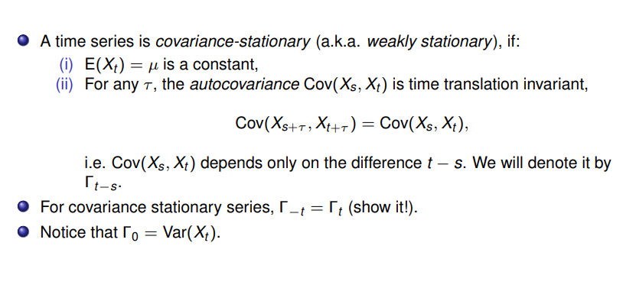
Autocovariance for Time Series

Slide 17
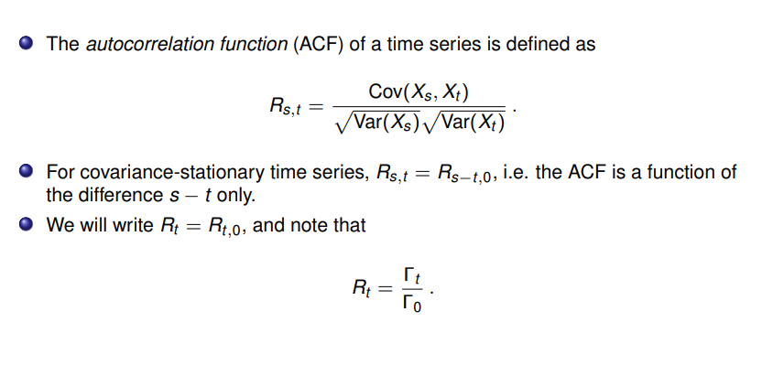
Autocorrelation for Time Series

Slide 18
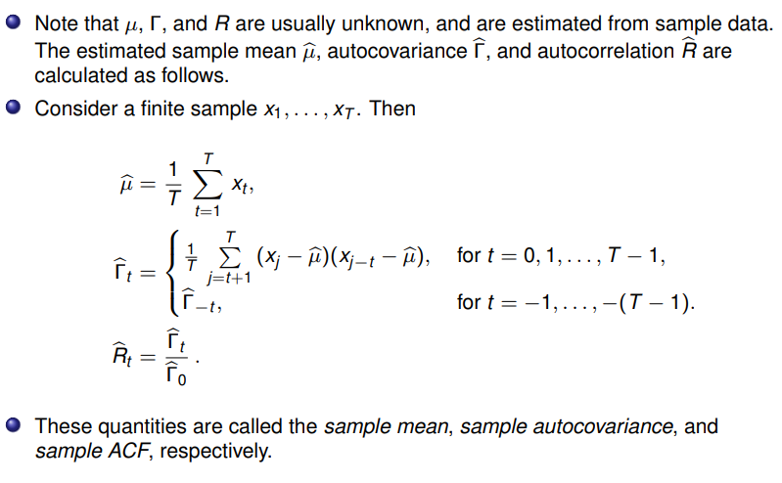

Slide 19
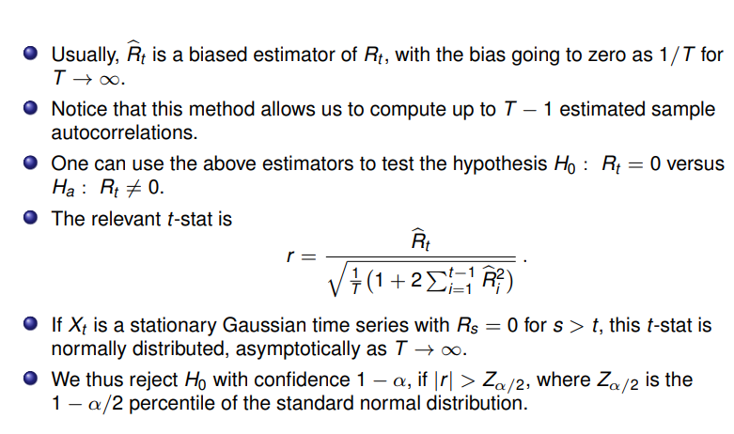

Slide 20
Testing Stationarity
What Augmented Dickey-Fuller (ADF) test ?
Imagine a series where a fraction of the current value is depending on a fraction of previous value of the series.
DF builds a regression line between fraction of the current value Δy_{t} and fraction of previous value δy_{t-1}
The usual t-statistic is not valid as difference term is introduced,
thus D-F developed appropriate critical values. Which follows DF distribution
If P value of DF test is <5% then the series is stationary

Slide 21
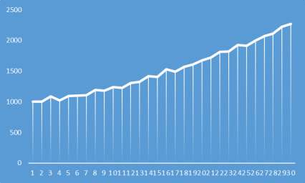
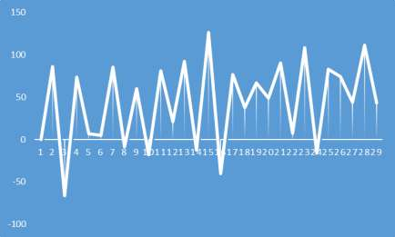
Differentiation-The first difference of a time series is the series of changes from one period to the next.
Actual Series
Series After
Differentiation

Slide 22
ARIMA Models
ARIMA stands for Auto-Regressive Integrated Moving Average.
AR Autoregression. A model that uses the dependent relationship between an observation and some number of lagged observations.
I Integrated. The use of differencing of raw observations in order to make the time series stationary.
MA Moving Average. A model that uses the dependency
between an observation and a residual error from a moving average model applied to lagged observations.
Each of these components are explicitly specified in the model as a parameter.

Slide 23
Notations
A standard notation is used of ARIMA(p, d, q) where the parameters are substituted with integer values to quickly indicate the specific ARIMA model being used.
p The number of lag observations included in the model, also called the lag order.
d The number of times that the raw observations are differenced, also called the degree of differencing.
q The size of the moving average window, also called the order
of moving average.
A value of 0 can be used for a parameter, which indicates to not use that element of the model.
26 / 77

Slide 24
Autoregressive Models
Intuition
– Autoregressive models are based on the idea that current value of the series, X_{t} , can be explained as a linear combination of p past values, X_{t−1}, X_{t−2}, . . . , X_{t−p} , together with a random
error in the same series.
Definition
– An autoregressive model of order p, abbreviated AR(p), is of the form
p
Σ
X = φ X + φ X + · · · + φ X + w = φ X
+ w
t 1 t−1 2 t−2 p t−p t i t−i t
i =1
2
where X is stationary, w ∼ wn(0, σ ), and φ , φ , . . . , φ
t t w 1 2 p
(φ_{p} =/ 0) are model parameters. The hyperparameter p
represents the length of the “direct look back” in the series.

Slide 25
Backshift Operator
Before we dive deeper into the AR process, we need some new notations to simplify the representations.
Backshift Operator
– The backshift operator is defined as
BX_{t} = X_{t−1}.
It can be extended, B²X_{t} = B(BX_{t} ) = B(X_{t−1}) = X_{t−2}, and so on. Thus,
B^{k} X_{t} = X_{t−k}

Slide 26
Autoregressive Operator of AR Process
Recall the definition for AR(p) process:
X_{t} = φ₁X_{t−1} + φ₂X_{t−2} + · · · + φ_{p} X_{t−p} + w_{t} By using the backshift operator we can rewrite it as:
X_{t} − φ₁X_{t−1} − φ₂X_{t−2} − · · · − φ_{p} X_{t−p} = w_{t}
(1 − φ₁B − φ₂B² − · · · − φ_{p} B^{p} )X_{t} = w_{t}
The autoregressive operator is defined as:
p
2 p j
Σ
φ(B) = 1 − φ B − φ B − · · · − φ B = 1 − φ B ,
1 2 p j
j =1
then the AR(p) can be rewritten more concisely as:
φ(B)X_{t} = w_{t}

Slide 27
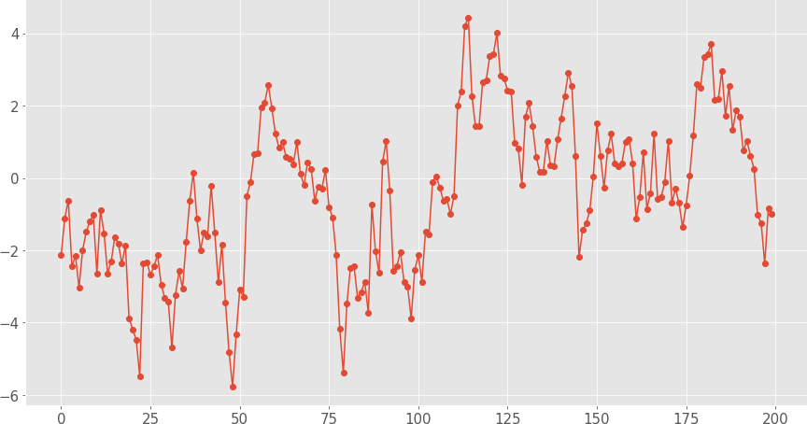
AR Examples: AR(1) Process
Simulated AR(1) Process X_{t} = 0.9X_{t−1} + w_{t} :
Mean
E [X_{t} ] = 0
_{σ}2
Variance
Var(X ) =
w
t
2
(1 − φ )
1

Slide 28
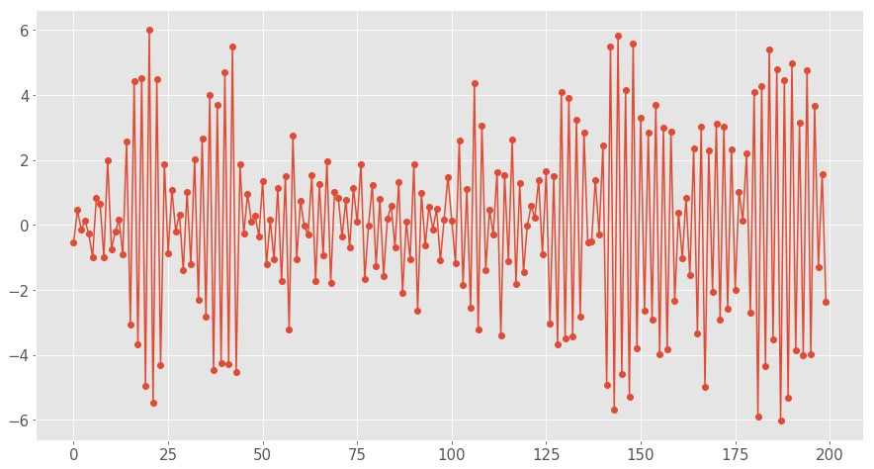
AR Examples: AR(1) Process
Simulated AR(1) Process X_{t} = −0.9X_{t−1} + w_{t} :
Mean
E [X_{t} ] = 0
_{σ}2
Variance
Var(X ) =
w
t
2
(1 − φ )
1

Slide 29
AR Models: Parameters Estimation
Note that p is like a hyperparameter for the AR(p) process, thus fitting an AR(p) model presumes p is known and only focusing on estimating coefficients, i.e. φ₁, φ₂, . . . , φ_{p} .
There are many feasible approaches:
Method of moments estimator
Maximum Likelihood Estimation (MLE) estimator
Ordinary Least Squares (OLS) estimator

Slide 30

Maximum likelihood estimation
Maximum likelihood estimation (MLE) is a commonly used method of estimating the parameters of a statistical model given a set of observations.
It is based on the premise that the best choice of the parameter values should maximize the likelihood of making the observations given these parameters.
Given a statistical model with parameters θ = (θ₁, . . . , θ_{d} ), and a set of data
y = (y₁, . . . , y_{N} ), we construct the likelihood function L(θ|y ), which links the model with the data in such a way as if the data were drawn from the assumed model.
In practice, L(θ|y ) is the joint probability density function (PDF) p(y |θ) under the
model, evaluated at the observed values.
In particular, if the observations y_{i} are independent, then
N
L(θ|y ) = p(y |θ),
Y
i
i =1
where p(y_{i} |θ) denotes the PDF of a single observation.

Slide 31
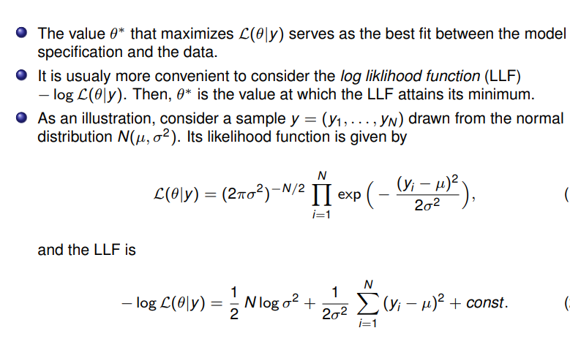

Slide 32
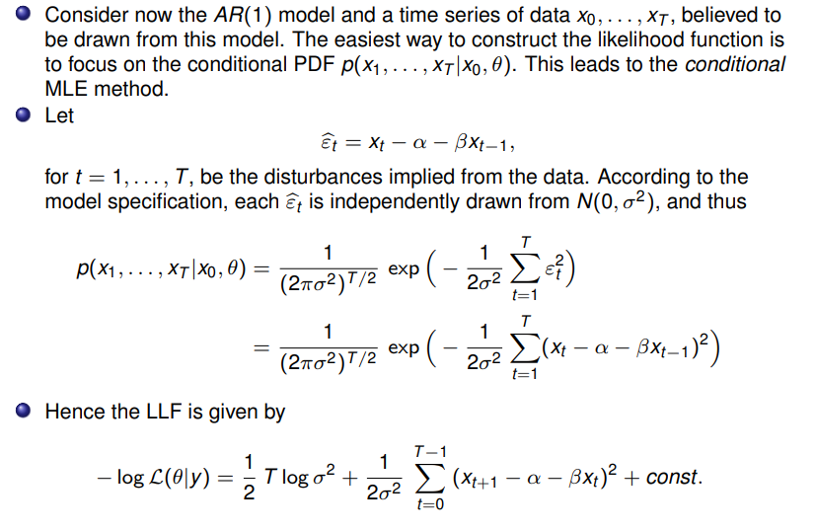

Slide 33
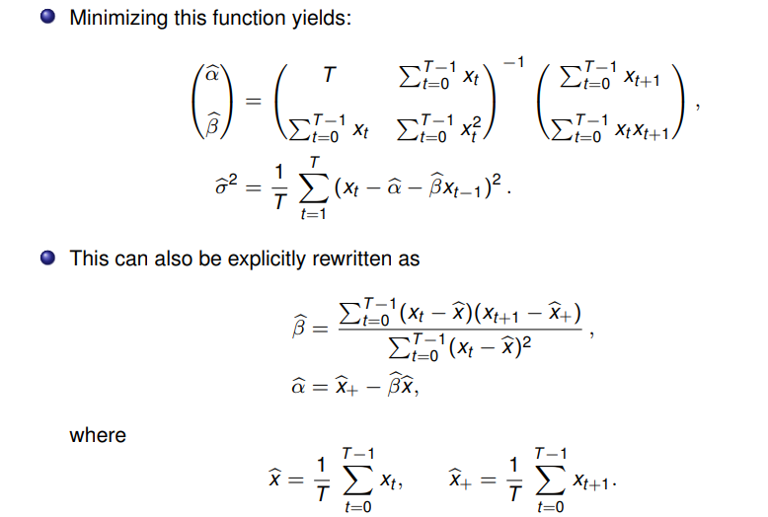

Slide 34
Moving Average Models (MA)
Motivation
Recall that in AR models, current observation X_{t} is regressed using the previous observations X_{t−1}, X_{t−2}, . . . , X_{t−p} , plus an error term w_{t} at current time point.
Based on the residuals i.e X_{t -} X_{t−1} =e
One problem of AR model is the ignorance of correlated noise structures (which is unobservable) in the time series.
In other words, the imperfectly predictable terms in current
time, e_{t} , and previous steps,e_{t−1}, e_{t−2}, . . . , e_{t−q} , are also informative for predicting observations.

Slide 35
Moving Average Models (MA)
Definition
– A moving average model of order q, or MA(q), is defined to be
q
Σ
X = e + θ e + θ e + · · · + θ e = e + θ e
t t 1 t−1 2 t−2 q t−q t j t−j
j =1
where e ∼ N(0, σ ), and θ , θ , . . . , θ (θ =/ 0) are
2
t e 1 2 q q
parameters.
– Although it looks like a regression model, the difference is that the w_{t} is not observable.
Contrary to AR model, finite MA model is always stationary, because the observation is just a weighted moving average over past forecast errors.

Slide 36
Moving Average Operator
Moving Average Operator
– Equivalent to autoregressive operator, we define moving average operator as:
θ(B) = 1 + θ₁B + θ₂B² + · · · + θ_{q} B^{q},
where B stands for backshift operator, thus B(e_{t} ) = e_{t−1}.
Therefore the moving average model can be rewritten as:
X_{t} = e_{t} + θ₁e_{t−1} + θ₂e_{t−2} + · · · + θ_{q}e_{t−q}
X_{t} = (1 + θ₁B + θ₂B² + · · · + θ_{q} B^{q} )e_{t}
X_{t} = θ(B)e_{t}

Slide 37
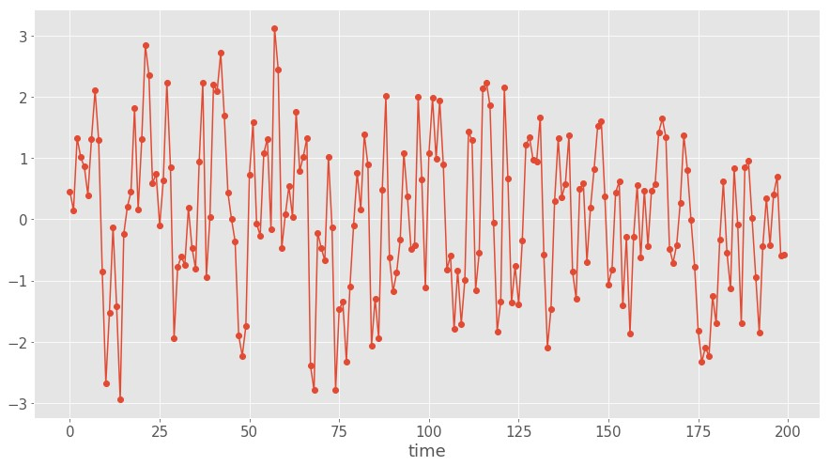
MA Examples: MA(1) Process
Simulated MA(1) Process X_{t} = e_{t} + 0.8 × e_{t−1}:
Mean E [X_{t} ] = 0
Variance Var(X_{t} ) = σ² (1 + θ²)
e 1

Slide 38
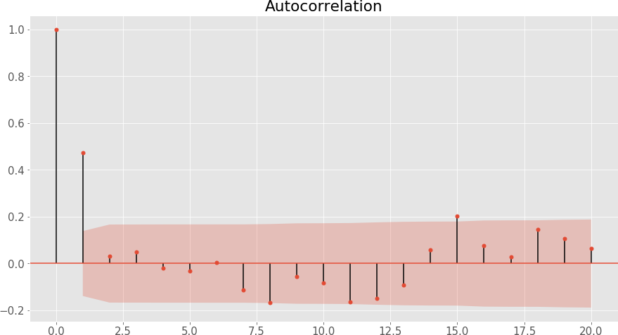
MA Examples: MA(1) Process
Autocorrelation Function (ACF)
θ₁
ρ = ρ = 0, ∀h ≥ 2
1
1 + θ²
h
1

Slide 39
General MA(q) Process
An important property of MA(q) models in general is that there are nonzero autocorrelations for the first q lags, and ρ_{h} = 0 for all lags h > q.
In other words, ACF provides a considerable amount of information about the order of the dependence q for MA(q) process.
Identification of an MA model is often best done with the ACF

Slide 40
“Stationarize” Nonstationary Time Series
One limitation of ARIMA models is the stationarity condition.
In many situations, time series can be thought of as being composed of two components, a non-stationary trend series and a zero-mean stationary series, i.e. X_{t} = µ_{t} + Y_{t} .
Strategies
Detrending: Subtracting with an estimate for trend and deal with residuals.
Y^{ˆ}_{t} = X_{t} − µˆ_{t}
Differencing: Recall that random walk with drift is capable of representing trend, thus we can model trend as a stochastic component as well.
µ_{t} = δ + µ_{t−1} + w_{t}
∇X_{t} = X_{t} − X_{t−1} = δ + w_{t} + (Y_{t} − Y_{t−1}) = δ + w_{t} + ∇Y_{t}
∇ is defined as the first difference and it can be extended to higher orders.

Slide 41
Differencing
One advantage of differencing over detrending for trend removal is that no parameter estimation is required.
In fact, differencing operation can be repeated.
The first difference eliminates a linear trend.
A second difference, i.e. the difference of first difference, can eliminate a quadratic trend.
Recall the backshift operator X_{t} = BX_{t−1}:
∇X_{t} = X_{t} − X_{t−1} = X_{t} − BX_{t} = (1 − B)X_{t}
2
∇ X_{t} = ∇(∇X_{t} ) = ∇(X_{t} − X_{t−1})
= (X_{t} − X_{t−1}) − (X_{t−1} − X_{t−2})
= X_{t} − 2X_{t−1} + X_{t−2} = X_{t} − 2BX_{t} + B²X_{t}
= (1 − 2B + B²)X_{t} = (1 − B)²X_{t}

Slide 42
Detrending vs. Differencing
original
60 70 80 90 110
●●●●●
●● ●
●●●●●●●● ●●●
●●●●●●
●
●
●●●●
●
● ●●●●●●
●●
●●
●
chicken
●●
●●●●●
●●
●●
●●●
●●●●
●●●
●●●●
●●●●● ● ●
● ● ●
●● ●
●●●●●
●
●
●●●●
● ●
● ●●●●
●
●●
●
●
●●●●
● ●
●
●
●
●●●
●
●
●
●
●●●●●●●●●●●● ●
●
●
● ●
●● ●●●●●●
●●●●
●●●●●●
●●●
●
●
●
●●●● ● ●
●●●●●● ●● ●● ●
●
2005
2010
2015
Time
detrended
−5 0 5 10
●
● ●
●
●
●
● ●
●● ●
●● ●●● ● ●●
●
●
●
●●
●
●
●
●●
●
●
●●
●
●
resid(fit)
●
●
●
● ●
●
●
●●
● ●●●●
●
●
●
●
●
●● ●●
● ● ●
● ●
●●●●●
● ●●●
●
●
●
●●●●
●
●
●
●
●
●●●● ● ●
●●●●
●
● ●
●
● ●
●
●●●●
●
● ●● ●
●
●
● ●● ●
●
●
●
● ●
●
●
●
●
●
●
●
●● ●●
●●●●●●
●
●
●●
●
●
●
●●
●
●
●
●
●●●
●●●●
●●●●
● ●
● ● ●
● ●●●●●
●● ●
●●
●●
2005
2010
2015
Time
first difference
−2 −1 0 1 2 3
●
●
●
●
●
●
●
● ●
●
●
●
●
●
●
●
●
●
●
●
diff(chicken)
●
●
●
●
● ●●
●
●
●
●●
●
●
●
● ●
● ●
●
●
●
● ● ●
●
●●●
● ●●
● ●●
●● ● ●
●
●
●
● ●
●●
●
●
● ●
●
●
●
●●
●
● ● ●
●
● ●● ● ●
● ●
● ●●●
●
●
●
●
●● ●
●
●● ●
● ●
●
● ●
● ●●
● ●●
● ●
● ●●
●
●
●
●● ●
● ● ● ●
●● ●●● ●
● ●● ●
●
●
●
● ●
●
●
●
●
●
●
● ●
●
●
●●
●
●
●
●
●
●
●
●
●
●
●
●
●
●
●
●
●
●
●
●
●
●
●
●
2005
2010
2015
Time

Slide 43
Box-Jenkins Methods
As we have seen ARIMA models have numerous parameters and hyper parameters, Box and Jenkins suggests an iterative three-stage approach to estimate an ARIMA model.
Procedures
Model identification: Checking stationarity and seasonality, performing differencing if necessary, choosing model specification ARIMA(p, d, q).
Parameter estimation: Computing coefficients that best fit the selected ARIMA model using maximum likelihood estimation or non-linear least-squares estimation.
Model checking: Testing whether the obtained model conforms
to the specifications of a stationary univariate process (i.e. the residuals should be independent of each other and have constant mean and variance).

Slide 44
Selected Time series Dataset
This dataset provides monthly totals of a US airline passengers from 1949 to 1960.
This dataset is taken from an inbuilt dataset of R called AirPassengers.
Sample size: n = 144
Taken from Kaggle
“Month", "Thousands of Passengers"
"1949-01", 112
"1949-02", 118
"1949-03", 132
"1949-04", 129
"1949-05", 121
"1949-06", 135

Slide 45
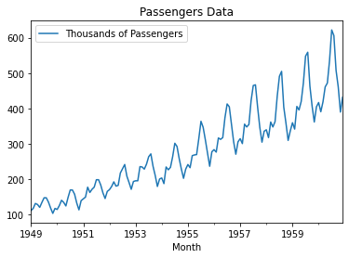
Air Passenger Data
Monthly totals of a US airline passengers, from 1949 to 1960

Slide 46
Model Identification
As with any data analysis, we should construct a time plot of the data, and inspect the graph for any anomalies.
The most important thing in this phase is to determine if the time series is stationary and if there is any significant seasonality that needs to be handled.
Test Stationarity
if the mean or variance changes over time then it’s non-stationary, thus an intuitive way is to plot rolling statistics.
We can also make an autocorrelation plot, as non-stationary time series often shows very slow decay.
A well-established statistical test called augmented
Dickey-Fuller Test can help. The null hypothesis is the time series is non-stationary.

Slide 47
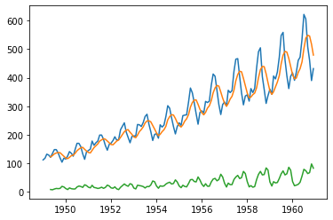
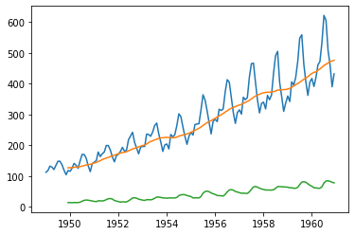
Stationarity Test: Rolling Statistics
Rolling statistics with sliding window of 5 months
Rolling statistics with sliding window of 12 months

Slide 48
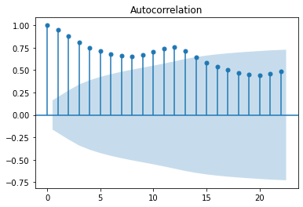
Stationarity Test: ACF Plot
Autocorrelation with varying lags
Notes:
This plot is roh k (autocorrelation) vs k

Slide 49
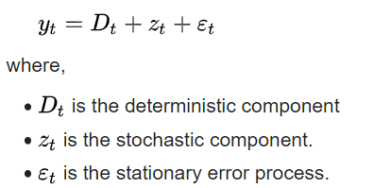
Unit root Test
Unit root test tests whether a time series variable is non-stationary and possesses a unit root.

Slide 50
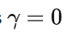
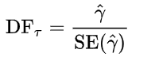
Stationarity Test
Null Hypothesis---------------- Data is stationary Alternative hypothesis ---- Data is not stationary
the unit root test is then carried out under the null hypothesis
against the alternative hypothesis
This is computed it can be compared to the relevant critical value for the Dickey–Fuller test. As this test is asymmetrical, we are only concerned with negative values of our test statistic
If the calculated test statistic is less (more negative) than the critical value, then the null hypothesis of is rejected and no unit root is present.

Slide 51
Stationarity Test: ADF Test
Results of Augmented Dickey-Fuller Test
Item | Value
Test Statistic | 0.815369
p-value | 0.991880
#Lags Used | 13.000000
Number of Observations Used | 130.000000
Critical Value (1%) | -3.481682
Critical Value (5%) | -2.884042
Critical Value (10%) | -2.578770
The test statistic is a negative number.
The more negative it is, the stronger the rejection of the null hypothesis.

Slide 52
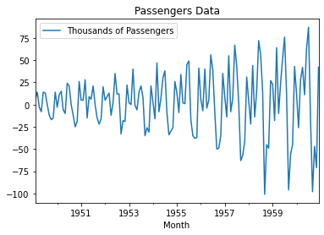
Lag-1

Slide 53
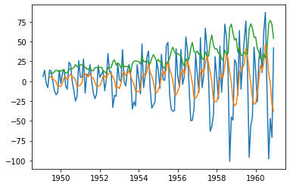
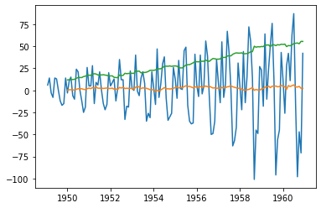
Rolling mean and variance plot
Rolling statistics with sliding window of 5 months
Rolling statistics with sliding window of 12 months
Mean is constant over time

Slide 54
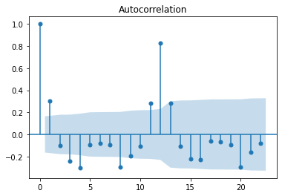
Stationarized Time Series: ACF Plot

Slide 55
Stationarized Time Series: ADF Test
Results of Augmented Dickey-Fuller Test
Item | Value
Test Statistic | -2.82926
p-value | 0.0542156
#Lags Used | 12
Number of Observations Used | 130
Critical Value (1%) | -3.4816
Critical Value (5%) | -2.884041
Critical Value (10%) | -2.578960
From the ACF plot, we can see that the mean and std variations have much smaller variations with time.
Also, the ADF test statistic is less than the 5% critical value, indicating the time series is stationary with 95% confidence.

Slide 56
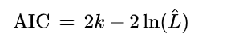
How to select the order(p,d,q)
Based on Akaike information criterion (AIC)
Which is an estimator of prediction error and thereby relative quality of statistical models for a given set of data
Given a collection of models for the data, AIC estimates the quality of each model order
Thus, AIC provides a means for model selection.
we have a statistical model of some data.
Let k be the number of estimated parameters in the model.
Let be the maximum value of the likelihood function for the model.
Then the AIC value of the model is the following

Slide 57
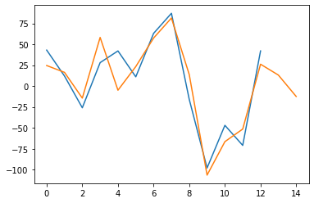
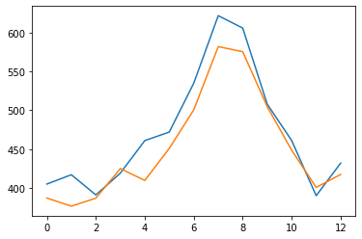
Forecasting
Using AR(13)
Using ARIMA(10,1,0)

Slide 58
Python Packages
Python has a statsmodels module provides time series analysis including AR, ARIMA.

Slide 59
References
Time series analysis and its applications, Shumway, Robert H and Stoffer, David S, 2017.
A comprehensive beginner’s guide to create a Time Series Forecast (with Codes in Python), https://www.analyticsvidhya.com/blog/2016/02/time-series- forecasting-codes-python/
STAT510: Applied Time Series Analysis, Penn State Online Courses –Slides
An Introductory Study on Time Series Modeling and Forecasting, Ratnadip Adhikari, R. K. Agrawal, 2013.
Wikipedia articles for various concepts.

Slide 60
Thank you

